Slide 1




Mai Xuân Tráng, PhD
Khoa Công Nghệ Thông Tin Trường Đại học Phenikaa Email: trang.maixuan@phenikaa-uni.edu.vn
SDT: 0965590406
1

Slide 2
Recap: what are software requirements?
Requirements specify what to build
describe what, not how
describe the problem, not the solution
reflect system design, not software design

Slide 3
Recap: goals and roles of requirements
Goals when eliciting requirements:
Understand precisely what is required of the software.
Communicate this understanding precisely to all involved parties.
Control production to ensure that system meets specification.
Roles of requirements (different levels):
Customers: what should be delivered (contractual base).
Managers: scheduling and monitoring (progress indicator).
Designers: a spec to design the system.
Coders: a range of acceptable implementations.
QA / Testers: a basis for testing, verification, and validation.

Slide 4
Today
More on requirements
Use cases

Slide 5
DRY, abstraction, and optimization
DRY principle: Don't Repeat Yourself Abstraction
Abstractions live longer than details
A good abstraction allows you to change/fix details later
Premature optimization is the root of all evil [Donald Knuth]

Slide 6
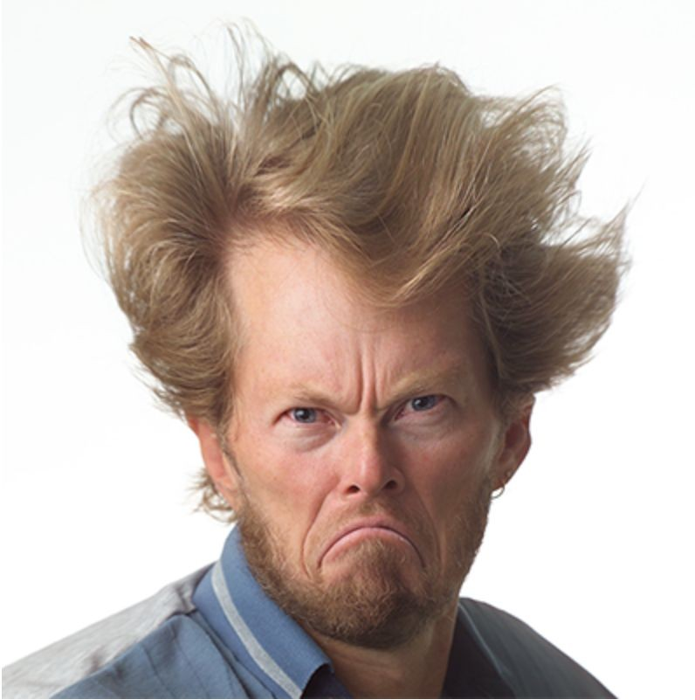
Requirements and use cases
Alistair Cockburn

Slide 7
Cockburn’s requirements template
Purpose and scope
Terms (glossary)
Use cases (the central artifact of requirements)
Technology used
Other
Development process: participants, values (fast-good-cheap), visibility, competition, dependencies
Business rules (constraints)
Performance demands
Security, documentation
Usability
Portability
Unresolved (deferred)
Human factors (legal, political, organizational, training)

Slide 8
What is a use case?
A use case is a written description of a user's interaction with the software system to accomplish a goal.
It is an example behavior of the system
3-9 clearly written steps lead to a “main success scenario”
Written from an actor's point of view, not the system’s
Terminology
Actor: someone (or another system) interacting with the system
Primary actor: person who initiates the action
Goal: desired outcome of the primary actor
Use cases capture functional requirements of a system!

Slide 9
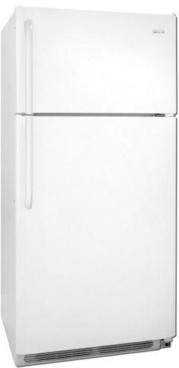
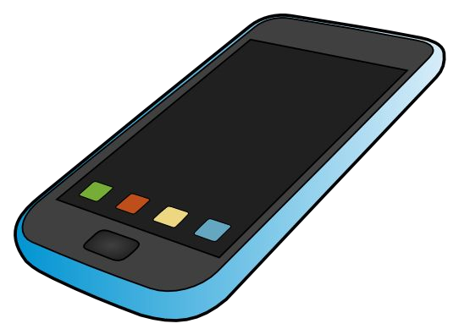

Back to the fridge
The smart fridge example
Recall your requirements (previous in-class activity)
Distinguish between use cases and internal features

Slide 10
Back to the fridge
The smart fridge example
Recall your requirements (previous in-class activity)
Distinguish between use cases and internal features
Use cases
Check inventory
Update inventory
Register a notification
Internal features
Transmit/receive data
SQL database backend
User I/O (display)

Slide 11
Benefits of use cases
Establish an understanding between the customer and the developers of the requirements (success scenarios)
Alert developers of problematic situations and error cases to test (extension scenarios)
Capture a level of functionality (list of goals)

Slide 12
What is an extension?
A possible branch in a use case, e.g., triggered by an error; useful for finding edge cases that need to be handled and tested
Do
Think about how every step of the use case could fail
Give a plausible response to each extension from the system
Response should either jump to another step of the case, or end it
Don’t
List things outside the use case ("User's power goes out")
Make unreasonable assumptions ("DB will never fail")
List a remedy that your system can't actually implement

Slide 13
Qualities of a good use case
Focuses on interaction
Starts with a request from an actor to the system
Ends with the production of all the answers to the request
Focuses on essential behaviors, from actor’s point of view
Does not describe internal system activities
Does not describe the GUI in detail
Concise, clear, and accessible to non-programmers
Easy to read
Summary fits on a page
Main success scenario and extensions

Slide 14
Use cases vs. requirements
Which of the following requirements should be directly represented as a use case?
Special deals may not run longer than 6 months.
Customers only become preferred after 1 year.
A customer has one and only one sales contact.
Database response time is less than 2 seconds.
Web site uptime requirement is 99.8%.
Number of simultaneous users will be 200 max.

Slide 15
Styles of use cases
Use case diagram (often in UML)
Textual use case
Formal use case (≠ formal specification)
Informal use case

Slide 16
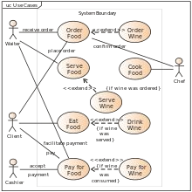
Use case diagram
“For reasons that remain a mystery to me, many people have focused on the stick figures and ellipses in use case writing since Jacobson's first book came out, and neglected to notice that use cases are fundamentally a text form.”
[Writing Effective Use Cases, Alistair Cockburn, 2000]

Slide 17
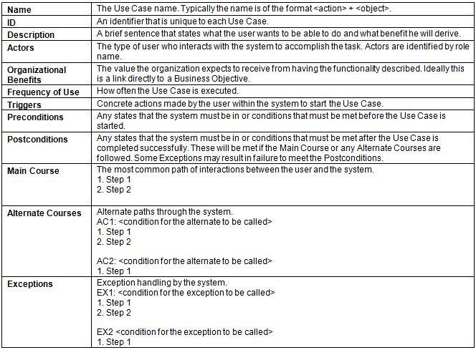
Formal use case

Slide 18
Use case diagram vs. textual use case
Which one would you choose and why?

Slide 19
Informal use case
Patron loses a book
The library patron reports to the librarian that she has lost a book. The librarian prints out the library record and asks patron to speak with the head librarian, who will arrange for the patron to pay a fee. The system will be updated to reflect lost book, and patron's record is updated as well. The head librarian may authorize purchase of a replacement book.

Slide 20
Informal use case with structured text
Use case 1: Patron loses a book
1.
a.
i.
Although not ideal, it is almost always better than unstructured text.
You will probably use something in this general style or a template for formal use cases.

Slide 21
Cockburn’s 4 steps for creating a use case
1. Identify actors and goals
Actors: What users and (sub)systems interact with our system?
Goals: What does each actor need our system to do?

Slide 22
Cockburn’s 4 steps for creating a use case
Identify actors and goals
Write the main success scenario
Main success scenario is the preferred "happy path”
Easiest to read and understand
Everything else is a complication on this
Capture each actor's intent and responsibility, from trigger to goal
State what information passes between actors
Number each step (line)

Slide 23
Cockburn’s 4 steps for creating a use case
Identify actors and goals
Write the main success scenario
List the failure extensions
Many steps can fail (e.g., denied credit card, out of stock)
Note each failure condition separately, after the main success scenario
Describe failure-handling
recoverable: back to main scenario (low stock + reduce quantity)
non-recoverable: fails (out of stock)
each scenario goes from trigger to completion
Label with step number (success scenario line) and letter
5a <failure condition>; 5a.1 <fail with error message>
5b <failure condition>; 5b.1 <action>; 5b.2 <continue at step 7>

Slide 24
Cockburn’s 4 steps for creating a use case
Identify actors and goals
Write the main success scenario
List the failure extensions
List the variations
Steps can have alternative behaviors
Label alternatives with step number (success scenario line) and symbol
5’ <Alternative 1 for step 5>
5’’ <Alternative 2 for step 5>

